Slide 1
HTML
Hypertext markup language
HTML is used to make web page
The latest version of HTML is HTML5
HTML is a document layout and hyperlink specification
language.
The code used to specify the formatting are called tags
Eg :<html></html>
A markup language is set of markup tags

Slide 2
HTML are two type of Elements
Container Elements
This type of HTML Elements require pair tags i.e a starting as well as an ending tag example:
<html>-------------</html>
<head>-------------</head>
<body>-------------</body>
<B>------------------</B>

Slide 3
HTML are two type of Elements
Empty Elements
This type of Elements require just a starting tag and not an ending tag some Example:
<BR>
<BASE>
<BASEFONT>
<IMG>
<LINK>

Slide 4
HTML BASIC
<html>
<head></head>
<title>This is document title</title>
<body>
<p>abcd</p>
<h1>abcd<h1>
<br />
<table> <tr> <td>abcd</td> <td>efge</td> </tr> </table>
<ul> <li>abcd<li> </ul>
</html>

Slide 5
HTML are three ways to insert style
Internal style
External style
Inline styles
Internal style
When a single document has a unique style an internal style sheet should be used.
You define internal style in the head section with the <style>tag.

Slide 6
HTML are three ways to insert style
External Style
When the style is applied to many pages.
An external style sheet is ideal.
Using an external style sheet, you can change the look of an entire web site by changing one file.
Inline style
When the style is applied to inside the html tag pages.
An inline style sheet is unique style.

Slide 7
CSS
CSS stands for Cascading style sheet
We can designed style to display HTML elements.
External style sheet are store in CSS files.
It improve content accessibility.
Enable multiple pages to share formating
Reduce complexity and repetition in the structural content.

Slide 8
CSS
ADVANTAGES
CSS saves times
Easy Maintenance:
CSS help to make the change of the layout and design of the site very easly.
Page load faster:
The file size of the css is very small hence your website takes minimal loading times.
A clean coding technique:
Which means search engines won’t have to struggle to “read” its contents
DISADVANTAGES
CSS does not work consistently in different browsers.
Internet Explorer and Opera support CSS in a pretty logical way unfortunately their logic does not conform to current CSS standards

Slide 9
CSS are 3 types styles have
<!Inline Style-->
<h1 style="background-color:red;">CSS background-color example!</h1> <div style="background-color:yellow;"> This is a text inside a div element.
<p style="background-color:orange;">
This paragraph has it's own background color.
</p>
We are still in the div element.
</div> </body> </html>

Slide 10
CSS are 3 types styles have
<!Internal style sheet-->
<style type="text/css"> body {background-image:url('images/img01.jpg');} </style> </head>
<body> <h1>Hello World!</h1> <p>This text is not easy to read on this background image.</p> </body>
</html>

Slide 11
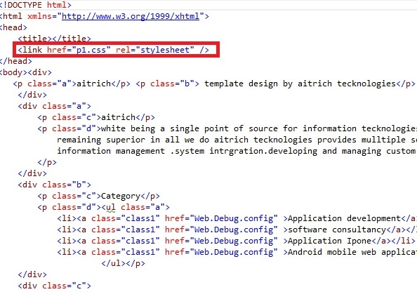
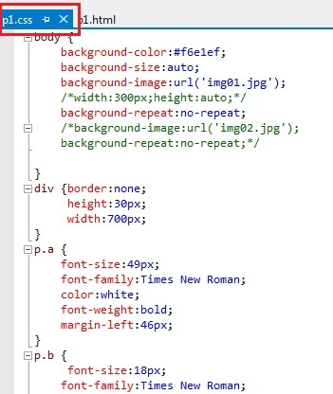
EXTERNAL STYLE

